Slide 1

Data Science project: Aphasia
KB-74
Notes:
We want to start off with an example of our progress in our team, we did get some knowledge from datacamp and coursera .

Slide 2
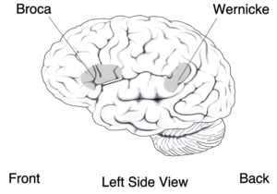
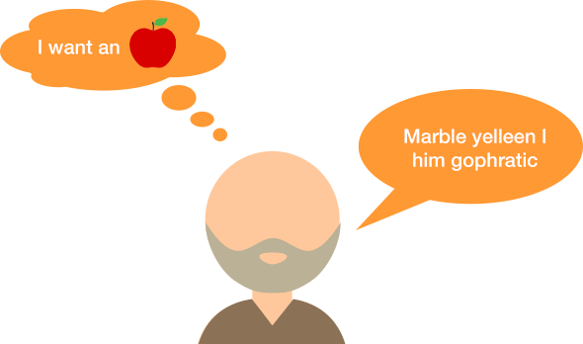
Aphasia
speech to text
Goal of the project: Create a speech to text software that can successful translate speech from aphasia patients.

Slide 3
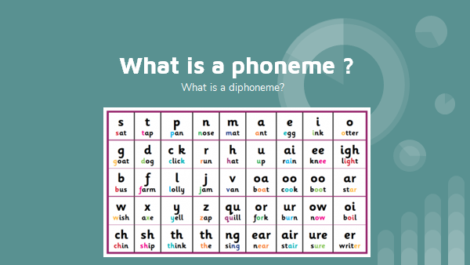

Slide 4
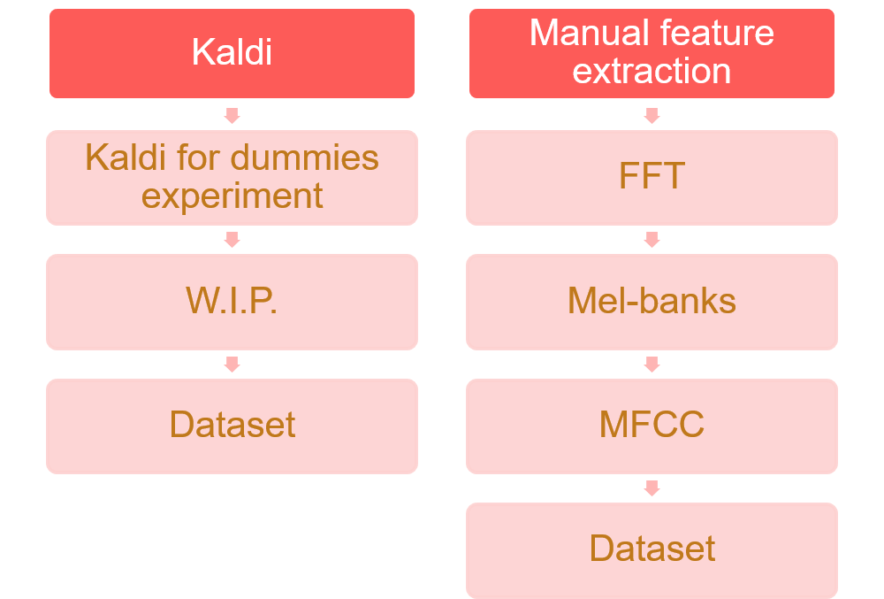

Slide 5

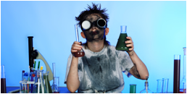
Kaldi
Kaldi Progress:
Got Kaldi working on the server
Getting more data in kaldi format
(short sentences with audio)
Facing some errors in Kaldi

Slide 6
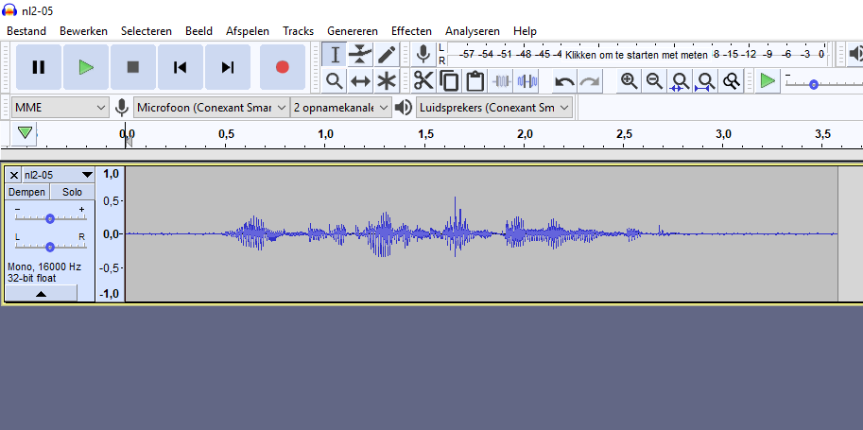
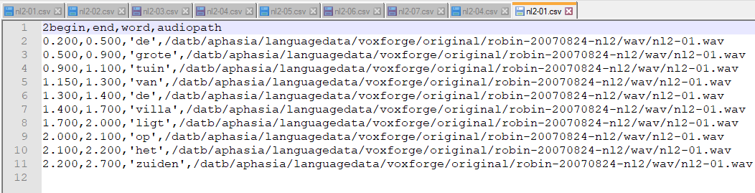
Creation of more data
Manual Checking,
Word Boundary
Translated words

Slide 7
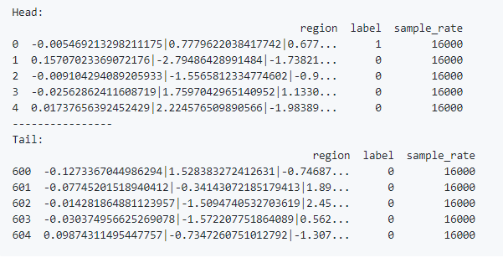
Current dataset
Region in MFCC,
label if word boundary
Sample rate

Slide 8

Classification experiments
RandomForestClassifier,
Logistic regression,
DecisionTree

Slide 9
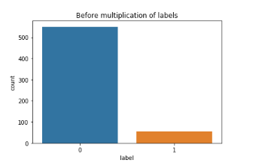
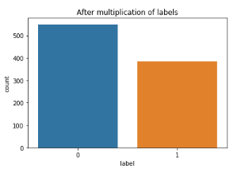
Amount of labels 0/1

Slide 10
Future work
Continue trying to use kaldi with more data
Using a different classifiers, to see what works best
Creating more data,
Finding more data.

Slide 11
Questions?
Any Questions?

